Slide 1


Introduction to Circuits Analysis
by Andrew G. Bell
abell118@ivytech.edu
(260) 481-2288
Lecture 4

Slide 2
CHAPTER 4
Series Circuits

Slide 3
Series Circuits
Definition: One path for current flow
Key Characteristic: The current is the same at any point in the circuit.

Slide 4
Series Circuits (cont.)
Total resistance in a series circuit is the summation of the individual resistor values:
R_{T} = R₁ + R₂ + R₃ … + R_{n}
Where n = the number of resistors

Slide 5
Series Circuits (cont.)
Total resistance in a series circuit can also be found using Ohm’s law.
Total resistance is equal to the circuit voltage divided by the current flowing in the circuit.

Slide 6
Mathematical Expression
Remember, I_{T} is the same at any point in the circuit.

Slide 7
Ohm’s Law
The equation may also be arranged to solve for Total Voltage (V_{T}) or Total Current (I_{T}):

Slide 8
Concept of Voltage Drop
A voltage drop is typically thought of as a voltage produced by allowing a current to flow through a resistance.

Slide 9
Voltage Drops in a Series Circuit
The voltage drop across a resistor in a series circuit is produced from the current flow through the resistor.

Slide 10
Calculating a Voltage Drop
If there are two resistors in a series circuit, each voltage drop may be calculated by using the following equations:
V_{R1} = I_{T} x R₁
V_{R2} = I_{T} x R₂

Slide 11
Voltage Divider Rule
The voltage across any resistor in a series may be determined by using the following equation:

Slide 12
Term Definitions
V_{X}: Voltage across the desired resistor
R_{X}: Value of the desired resistor
V_{T}: The circuit applied voltage

Slide 13
Kirchhoff’s Voltage Law
An important concept used in simple to very complex circuits
It allows one to solve problems and check answers
Used with Ohm’s law to solve difficult problems

Slide 14
Kirchhoff’s Voltage Law (cont.)
Kirchhoff’s Voltage Law (KVL) states:
The arithmetic summation of all voltage drops in a series circuit will always equal the applied voltage
and/or
The algebraic summation of the voltages around a loop will always equal zero volts

Slide 15
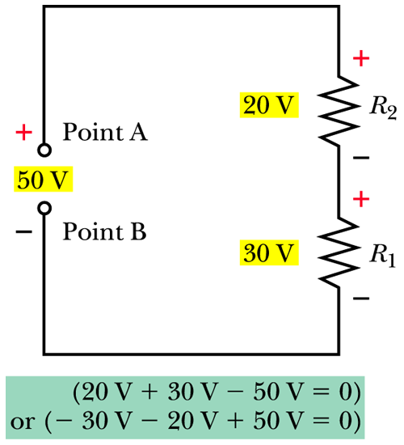
Kirchhoff’s Voltage Law (cont.)

Slide 16
Power in Series Circuits
Remember the basic equations:

Slide 17
Power in Series Circuits (cont.)
Because current is the same at every point in a series circuit, the resistance with the smallest value will also dissipate the smallest power value.
The largest resistor in the circuit will dissipate the largest amount of power.

Slide 18
Power in Series Circuits (cont.)
Since the current is the same at any point in a series circuit, the equation
P = I² x R is perhaps the best equation to use when I and R are known.
Thus, P_{R1} = I² x R₁ and P_{R2} = I² x R₂, etc.

Slide 19
Power in Series Circuits (cont.)
The total power dissipated in a series circuit is also the amount of power the power source must deliver. This may also be expressed as:
P_{T} = P_{R1} + P_{R2} … + P_{Rn}

Slide 20
Power in Series Circuits (cont.)
The total power may also be calculated using Watt’s law:
P_{T} = I² x R_{T}

Slide 21
Opens in a Series Circuit
An open circuit occurs anytime a break in the current path occurs.
If an open occurs at any point, current will decrease to 0 A.
All voltage drops will decrease to 0 V.

Slide 22
Opens in a Series Circuit (cont.)
An interesting aspect of an open is that the applied voltage will appear across the open point in the circuit.

Slide 23
Shorts in a Series Circuit
A short is an undesired, very low resistance path in or around a given circuit.
If a short occurs, current will increase because resistance decreases.
As current increases, the voltage across the remaining resistors will increase.

Slide 24
Shorts in a Series Circuit (cont.)
If a total short occurs, R_{T} = 0 Ω.
Current will attempt to increase to unacceptable levels.

Slide 25
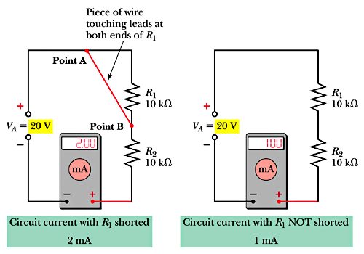
Shorts

Slide 26
Multiple Voltage Sources in Series
Series Aiding:
Negative terminal of one source is connected to the positive terminal of the other
Individual voltage sources add directly together:
V_{T} = V₁ + V₂

Slide 27
Multiple Voltage Sources in Series (cont.)
Series Opposing:
Negative terminal of one source is connected directly to the negative terminal of the second
Voltage sources subtract and result is polarized in direction of the greater source:
V_{T} = V₁ – V₂

Slide 28
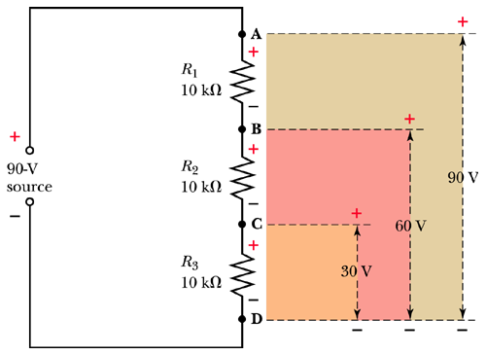
Voltage Divider
Resistive circuits used to obtain some percentage of the applied voltage source

Slide 29
Voltage Reference Points
The concept of voltage has both magnitude and polarity.
Specific points in a circuit to measure voltage
e.g., V_{ab} or V_{b}

Slide 30
Voltage Reference Points (cont.)
The voltage measured at the first subscript notation is with respect to the second subscript.
e.g., V_{ab} = -V_{ba}

Slide 31
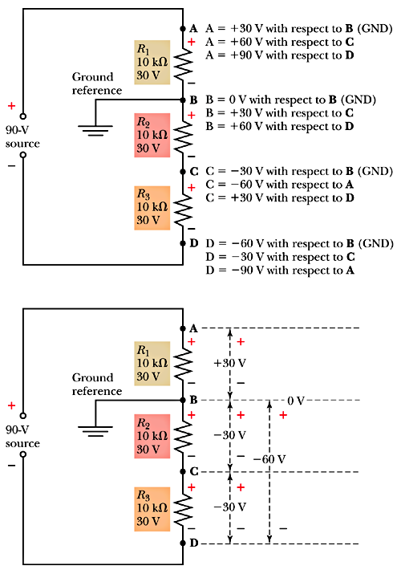
Voltage Reference Points (cont.)

Slide 32
Simpler Troubleshooting
Symptoms: Gather, verify and analyze
Identify: Possible areas of trouble
Make: Decisions—what, where
Perform: Tests or measurements
Locate: Narrow problem area
Examine: New location
Repeat: Procedure until problem found

Slide 33
Troubleshooting Levels
Block or module
Component
System

